Slide 1
Bigram Language Models

Slide 2
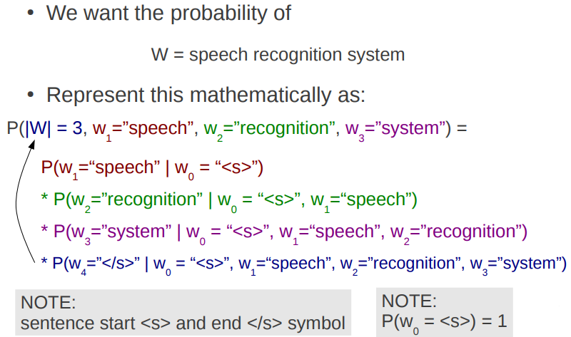
Review: Calculating Sentence Probabilities

Slide 3
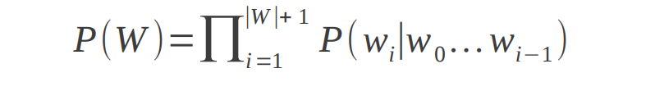
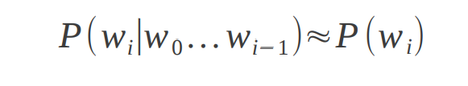
Incremental Computation
● Previous equation can be written:
● Unigram model ignored context:

Slide 4
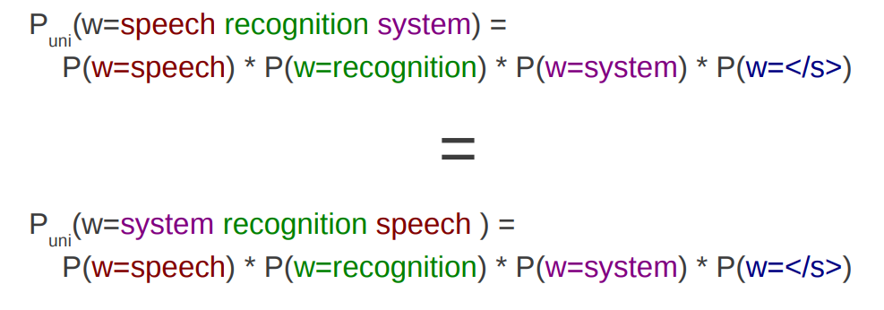
Unigram Models Ignore Word Order!
● Ignoring context, probabilities are the same:

Slide 5
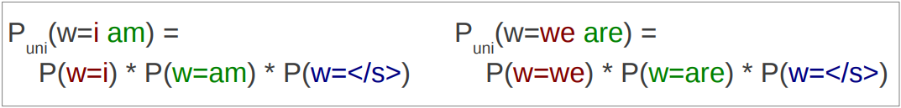
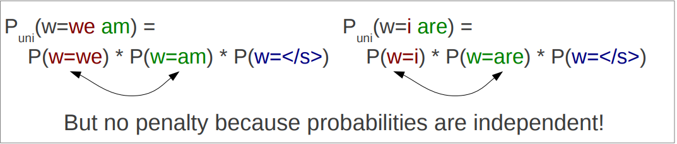
Unigram Models Ignore Agreement!
● Good sentences (words agree):
● Bad sentences (words don't agree)

Slide 6

Solution: Add More Context!
● Unigram model ignored context:
● Bigram model adds one word of context
● Trigram model adds two words of context

Slide 7
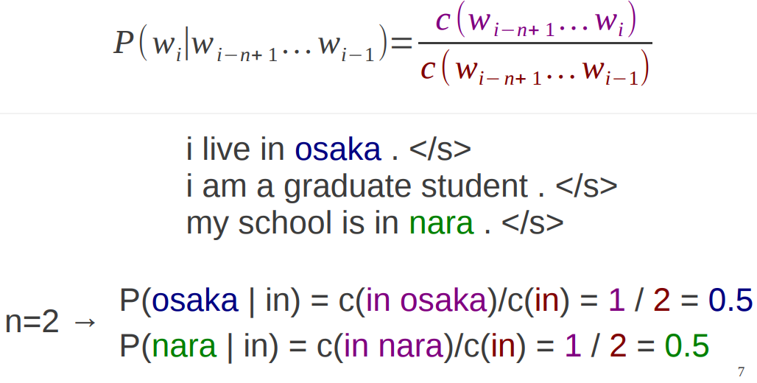
Maximum Likelihood Estimation of n-gram Probabilities
● Calculate counts of n word and n-1 word strings

Slide 8
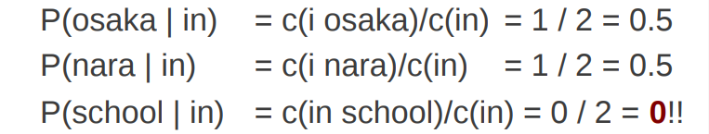
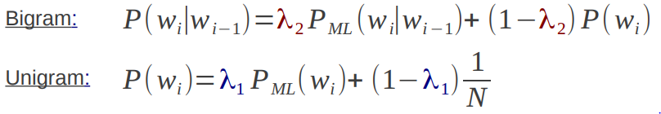
Still Problems of Sparsity
● When n-gram frequency is 0, probability is 0
● Like unigram model, we can use linear interpolation

Slide 9
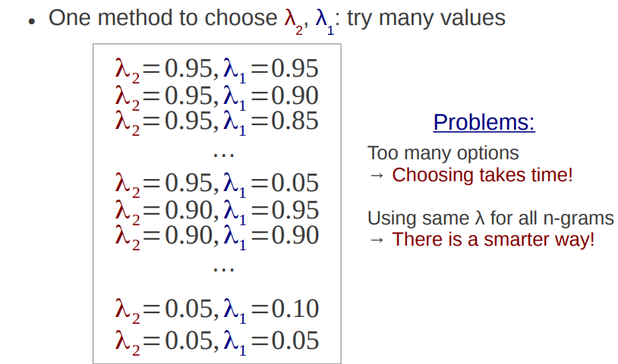
Choosing Values of λ: Grid Search

Slide 10
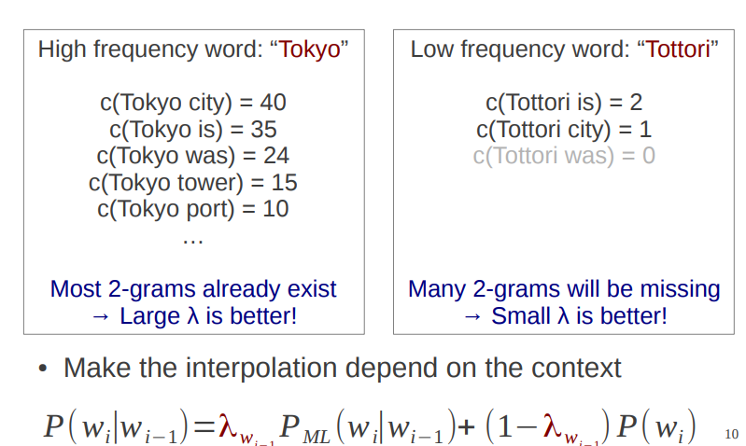
Context Dependent Smoothing

Slide 11
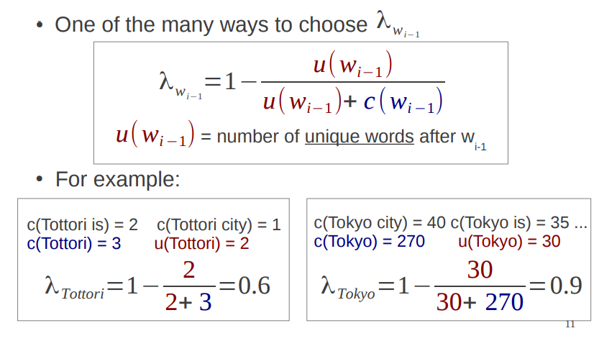
Witten-Bell Smoothing

Slide 12
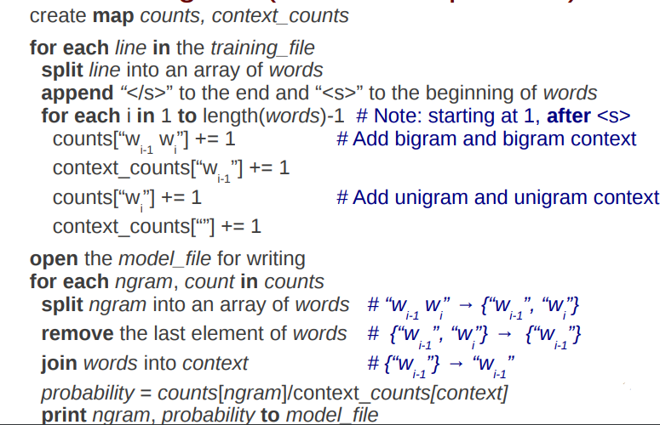
train-bigram (Linear Interpolation)

Slide 13
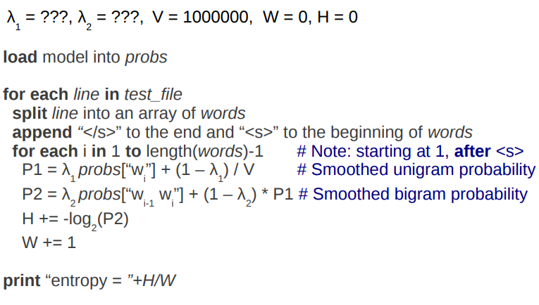
test-bigram (Linear Interpolation)

